Slide 1






Shaligram Infotech
INTERNSHIP
REPORT
HETVI PAREKH
200220131088

Slide 2


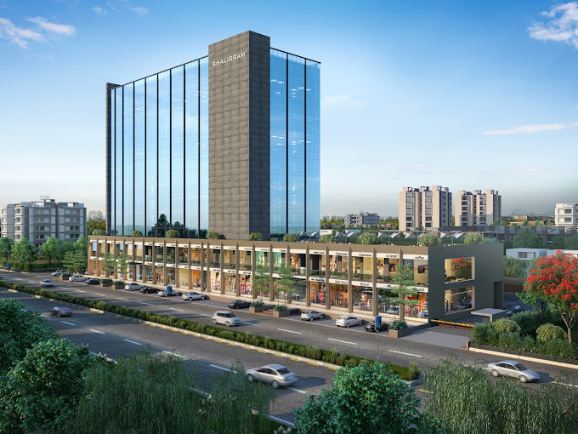


BRIEF INTRO OF COMPANY
Shaligram Infotech is a globally recognized Microsoft Gold Certified Partner that provides dedicated Microsoft Dynamics 365 development services.
We also offer a wide range of IT development services including software development, web app development, mobile app development, and app migration & modernization services among others.
Whether it is about offering end-to-end development or modernizing legacy software, Shaligram Infotech is equipped with working equally well for startups to small or mid-sized businesses to huge enterprises

Slide 3

BRIEF ON INTERNSHIP
As a full stack developer intern, I'll delve into a diverse range of technologies and frameworks, honing my proficiency in programming languages such as JavaScript and C#, while also mastering essential tools like HTML, CSS, and SQL.
I'll gain insights into the intricacies of front-end frameworks like .NET and Angular, as well as back-end frameworks like Node.js , acquiring a holistic understanding of building robust and scalable web applications.
Moreover, this internship isn't just about technical skills—it's also an opportunity for personal and professional growth. I'll cultivate essential soft skills such as communication, problem-solving, and collaboration, learning to effectively work within teams and adapt to fast-paced environments.

Slide 4

WEEK 1
Started with an orientation program , followed by engaging sessions on HTML and CSS. Then, received our first HTML/CSS task, which consists of a series of elements, each represented by tags, which define the different parts of a webpage such as headings, paragraphs, images, links, and more. .

Slide 5
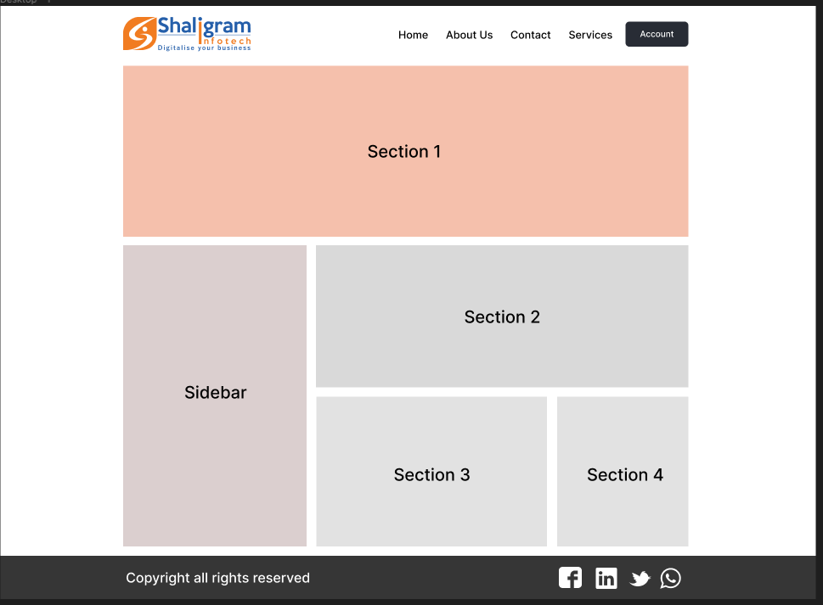
TASK 1

Slide 6

WEEK 2
On 2nd week, got second HTML/CSS task with the rich UI, which needed to be finished promptly on the 2 days. Then, had an insightful session on Bootstrap, followed by receiving and completing my first Bootstrap task. This ensures optimal viewing experience and usability on various devices, including desktops, tablets, and smartphones, without needing separate versions of the site for each device.

Slide 7

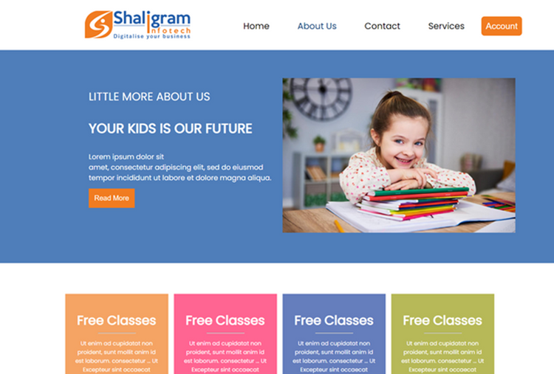
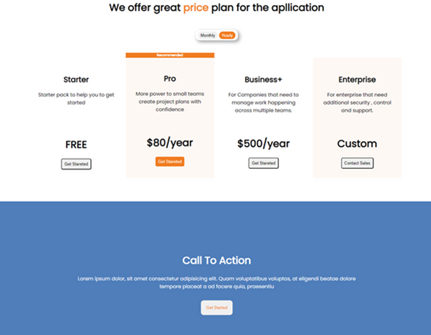
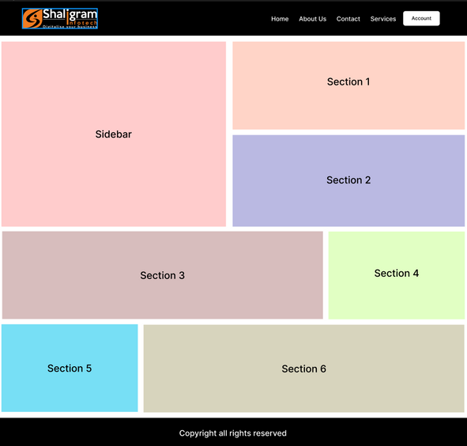
TASK 2
TASK 3

Slide 8

WEEK 3
On 3rd week, had our second Bootstrap session, delving deeper into its features. Then, received the second Bootstrap task, which , was a responsive admin dashboard. Utilizing techniques like flexible grids and media queries, it ensures efficient data presentation and user interaction. This enables administrators to manage tasks and monitor data conveniently .It was completed after two days. After that, we had our third Bootstrap session, expanding our understanding further.

Slide 9
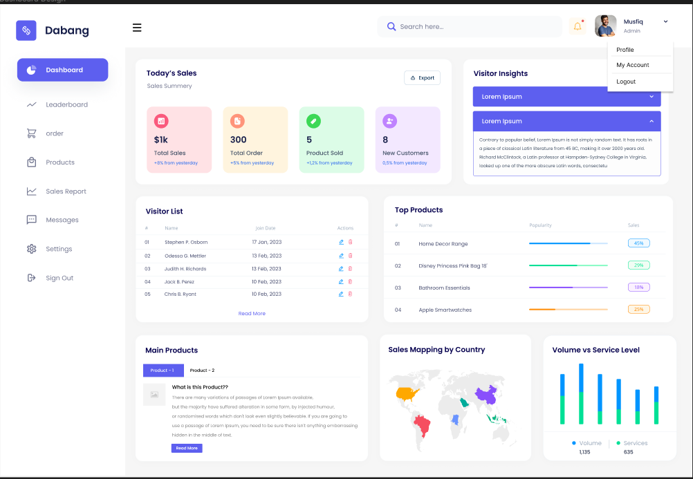
TASK 4

Slide 10

WEEK 4
On 4th week, received the third Bootstrap task, a responsive website with a rich UI .Continued making progress on the task on the next day, ensuring everything was coming together smoothly. Successfully completed the task with in two days. On the next day, took time to evaluate all previous tasks, incorporating feedback for improvements. Then after that, had an insightful first session on JavaScript, excited to delve into this new area of learning.

Slide 11
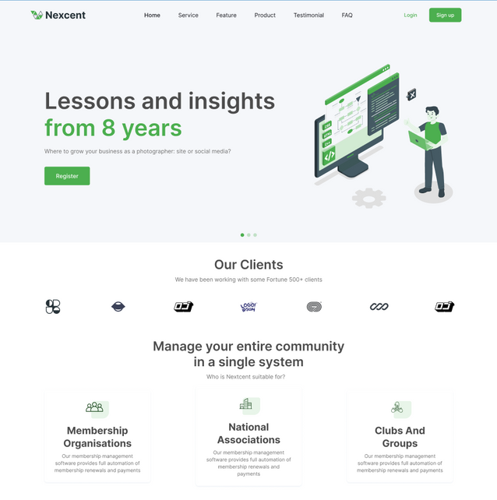
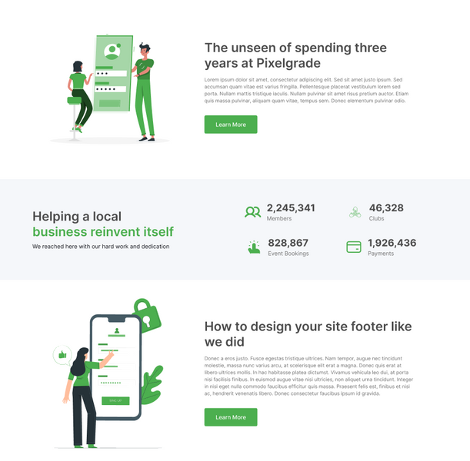
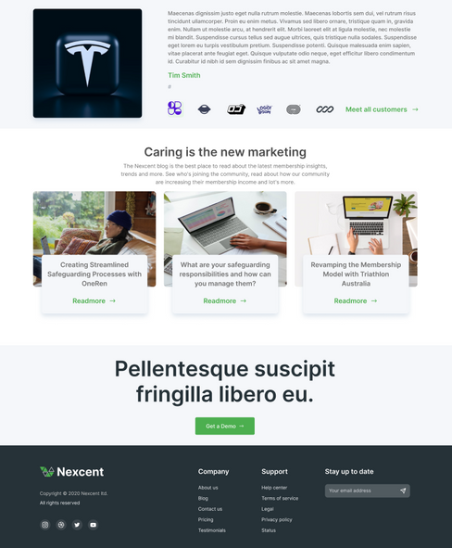
TASK 5

Slide 12
WEEK 5

Slide 13
TASK 6

Slide 14
WEEK 6

Slide 15
TASK 7

Slide 16
WEEK 7

Slide 17
WEEK 8

Slide 18
WEEK 9
On 9th week, taught about Temporary Tables, Magic Tables, the STUFF function, and XML path in SQL. On the next day, assigned tasks to practice different SQL queries. Wrapped up the SQL training , discussing IF statements and WHILE loops. Reviewed tasks from participants . Explored more SQL topics and practiced exercises ,continued learning and improvement.

Slide 20

WEEK 10
On 10th week, had a revision session for JavaScript to reinforce knowledge. Discussed exam preparations with the trainer and HR on the next day. Spent the next day practicing HTML, CSS, Bootstrap, and JavaScript for the upcoming exam. After that the self-study various SQL queries for exam practice. Finally, on March 30th, took the exam covering HTML, CSS, JavaScript, and SQL topics.

Slide 21
WEEK 11
On April 1st, attended a session to review the exam paper and address any uncertainties. Completed extra tasks from the exam for further practice on the next day. Spent next two days rectifying mistakes found in exam tasks to enhance understanding. Discussed solutions for the JavaScript section of the exam . After that, focused on self-learning SQL and JavaScript topics relevant to the exam for continuous improvement.

Slide 22

WEEK 12
On April 7th, administered the second exam covering HTML, CSS, JavaScript, jQuery, and SQL. Evaluated responses from the exam in a session. Reviewed and discussed solutions for the JavaScript and SQL parts of the exam. On the next day advancing our college project. Concentrated on developing practical solutions for the project. Finally conducted a comprehensive test on the project, ensuring it meets all requirements and correcting any identified flaws or errors.

Slide 23


RESOURCE PAGE
Use these design resources in your Canva Presentation. Happy designing! Delete or hide this page before presenting.

